Slide 1
JavaScript Day2
JS
Presented By : Asmaa Ahmed

Slide 2
Coercion
Number to String Conversion : When any string or non-string value is added to a string.
S tring to Number Conversion : When an operation like subtraction (-), multiplication (*), division (/) or modulus (%) is performed, all the values that are not number are converted into the number data type, as these operations can be performed between numbers only.

Slide 3
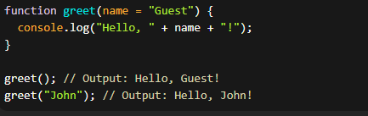
User Defined Function with default value
In JavaScript, you can define user-defined functions with parameters that have default values. This allows you to provide default values for parameters in case no arguments are passed when calling the function.

Slide 4
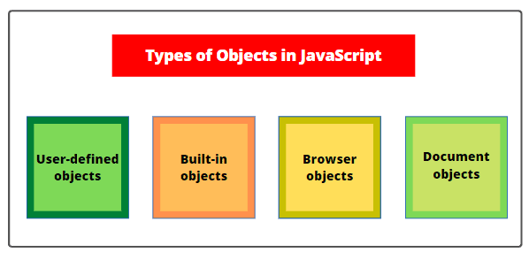
JavaScript Objects fall into 4 categories:
1.Custom Objects
Objects that you, as a JavaScript developer, create and use.
2.Built – in Objects
Objects that are provided with JavaScript to make your life as a JavaScript developer easier.
3.BOM Objects “Browser Object Model”
It is a collection of objects that are accessible through the global objects window. The browser objects deal with the characteristic and properties of the web browser.
4.DOM Objects “Document Object Model”
Objects provide the foundation for creating dynamic web pages. The DOM provides the ability for a JavaScript script to access, manipulate, and extend the content of a web page dynamically.

Slide 5
Built in objects
Object:
The Object represents a collection of key-value pairs and serves as the foundation for all JavaScript objects.
Array:
The Array object represents an ordered list of values and provides methods for manipulating and working with arrays.
String:
The String object represents a sequence of characters and provides methods for manipulating and working with strings.
Number:
The Number object represents numeric values and provides methods for working with numbers.
Boolean:
The Boolean object represents a Boolean value (true or false) and provides methods for working with Boolean values.

Slide 6
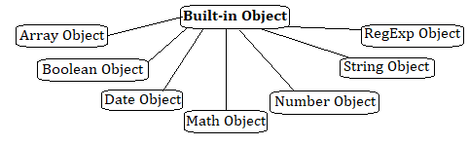
Built in objects
Date:
The Date object represents a specific point in time and provides methods for working with dates and times.
Math:
The Math object provides mathematical functions and constants for performing complex mathematical operations.
RegExp:
The RegExp object represents a regular expression, which is used for pattern matching and manipulation of strings.

Slide 7

String Object
The String object in JavaScript represents a sequence of characters and provides several properties and methods for working with strings. Here are some commonly used properties and methods of the String object:
Properties:
length: Returns the length of the string.

Slide 8


String Object
The String object in JavaScript represents a sequence of characters and provides several properties and methods for working with strings. Here are some commonly used properties and methods of the String object:
Methods:
charAt(index): Returns the character at the specified index in the string.
concat(string1, string2, ...) or + operator: Concatenates one or more strings together.

Slide 9


String Object
Methods:
indexOf(searchValue, startIndex): Returns the index of the first occurrence of the specified search value in the string, starting from the optional startIndex.
substring(startIndex, endIndex): Returns a substring of the original string, starting from the startIndex to the endIndex (excluding the endIndex).

Slide 10


String Object
Methods:
toUpperCase(): Converts the string to uppercase.
toLowerCase(): Converts the string to lowercase.
split(separator): Splits the string into an array of substrings based on the specified separator and returns the array.

Slide 11
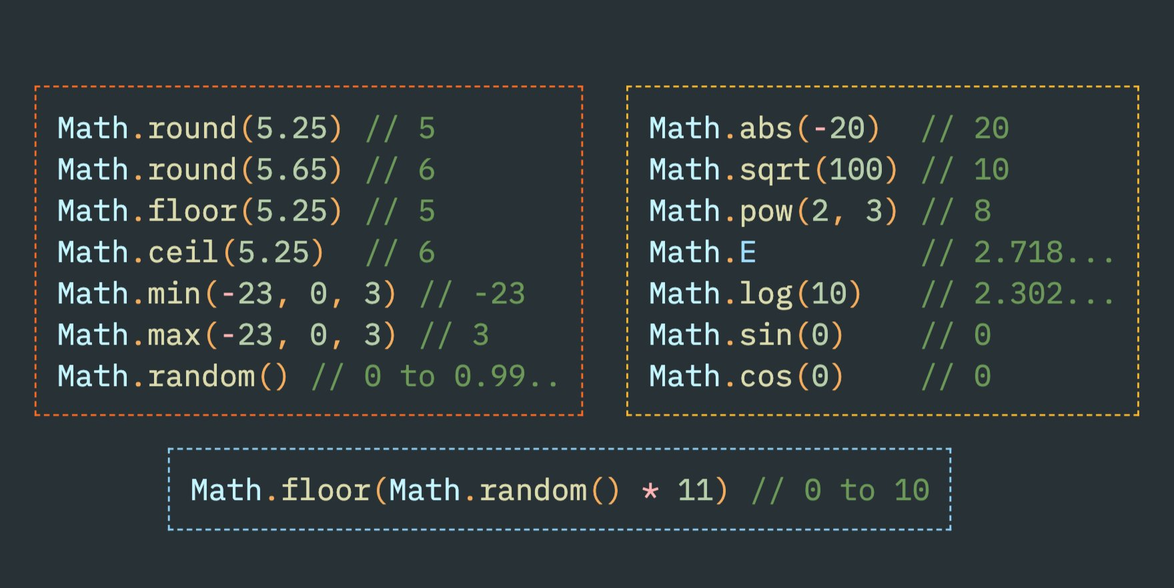
Math Object
The Math object is static. All methods and properties can be used without creating a Math object first. Math Properties (Constants).

Slide 12
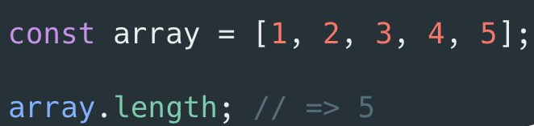
Array Object
JavaScript provides several built-in properties and methods for manipulating arrays. These methods allow you to add, remove, modify, and search for elements within an array. Here are some commonly used array object methods in JavaScript:
Properties:
length: Returns the length of the array.

Slide 13


Array Object
Methods:
push(): Adds one or more elements to the end of an array and returns the new length of the array.
pop(): Removes the last element from an array and returns that element.

Slide 14
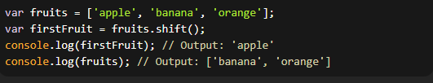

Array Object
Methods:
shift(): Removes the first element from an array and returns that element. The remaining elements' indexes are updated.
unshift(): Adds one or more elements to the beginning of an array and returns the new length of the array.

Slide 15
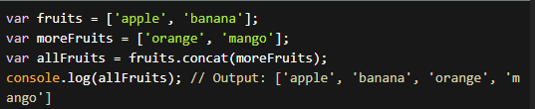

Array Object
Methods:
concat(): Returns a new array that combines the elements of the original array with other arrays or values.
slice(): Returns a shallow copy of a portion of an array into a new array, selected from the start index to the end index (end index not included).

Slide 16


Array Object
Methods:
splice(): Changes the contents of an array by removing, replacing, or adding elements at a specific position.
indexOf(): Returns the first index at which a given element is found in the array, or -1 if it is not present.

Slide 17
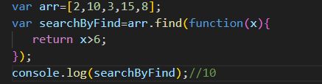
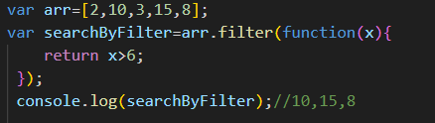
Array Object
Methods:
find(): Returns the first element in the array that match the provided testing function.
Filter() : returns an array containing the element that satisfies the condition.

Slide 18

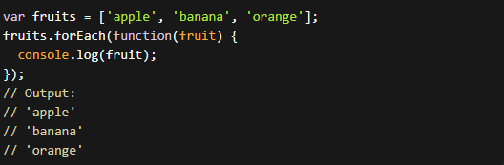
Array Object
Methods:
join(separator): Joins all elements of the array into a string using the specified separator.
forEach(): Executes a provided function once for each array element.

Slide 19
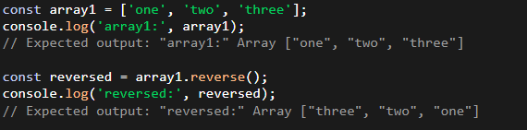
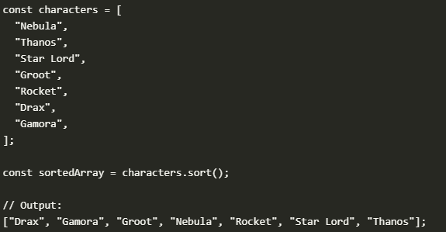
Array Object
Methods:
Reverse() : Reverses the order of the elements in an array
sort(): Sorts the elements of an array alphapitacally (By default, and can take a function for custom sort)

Slide 20
Date object
To obtain and manipulate the date and time in a script.
The Date object methods fall into these broad categories:
1. “get" methods : for getting date and time values from date objects
2. "set" methods :for setting date and time values in date objects
3. "to" methods : for returning string values from date objects.

Slide 21
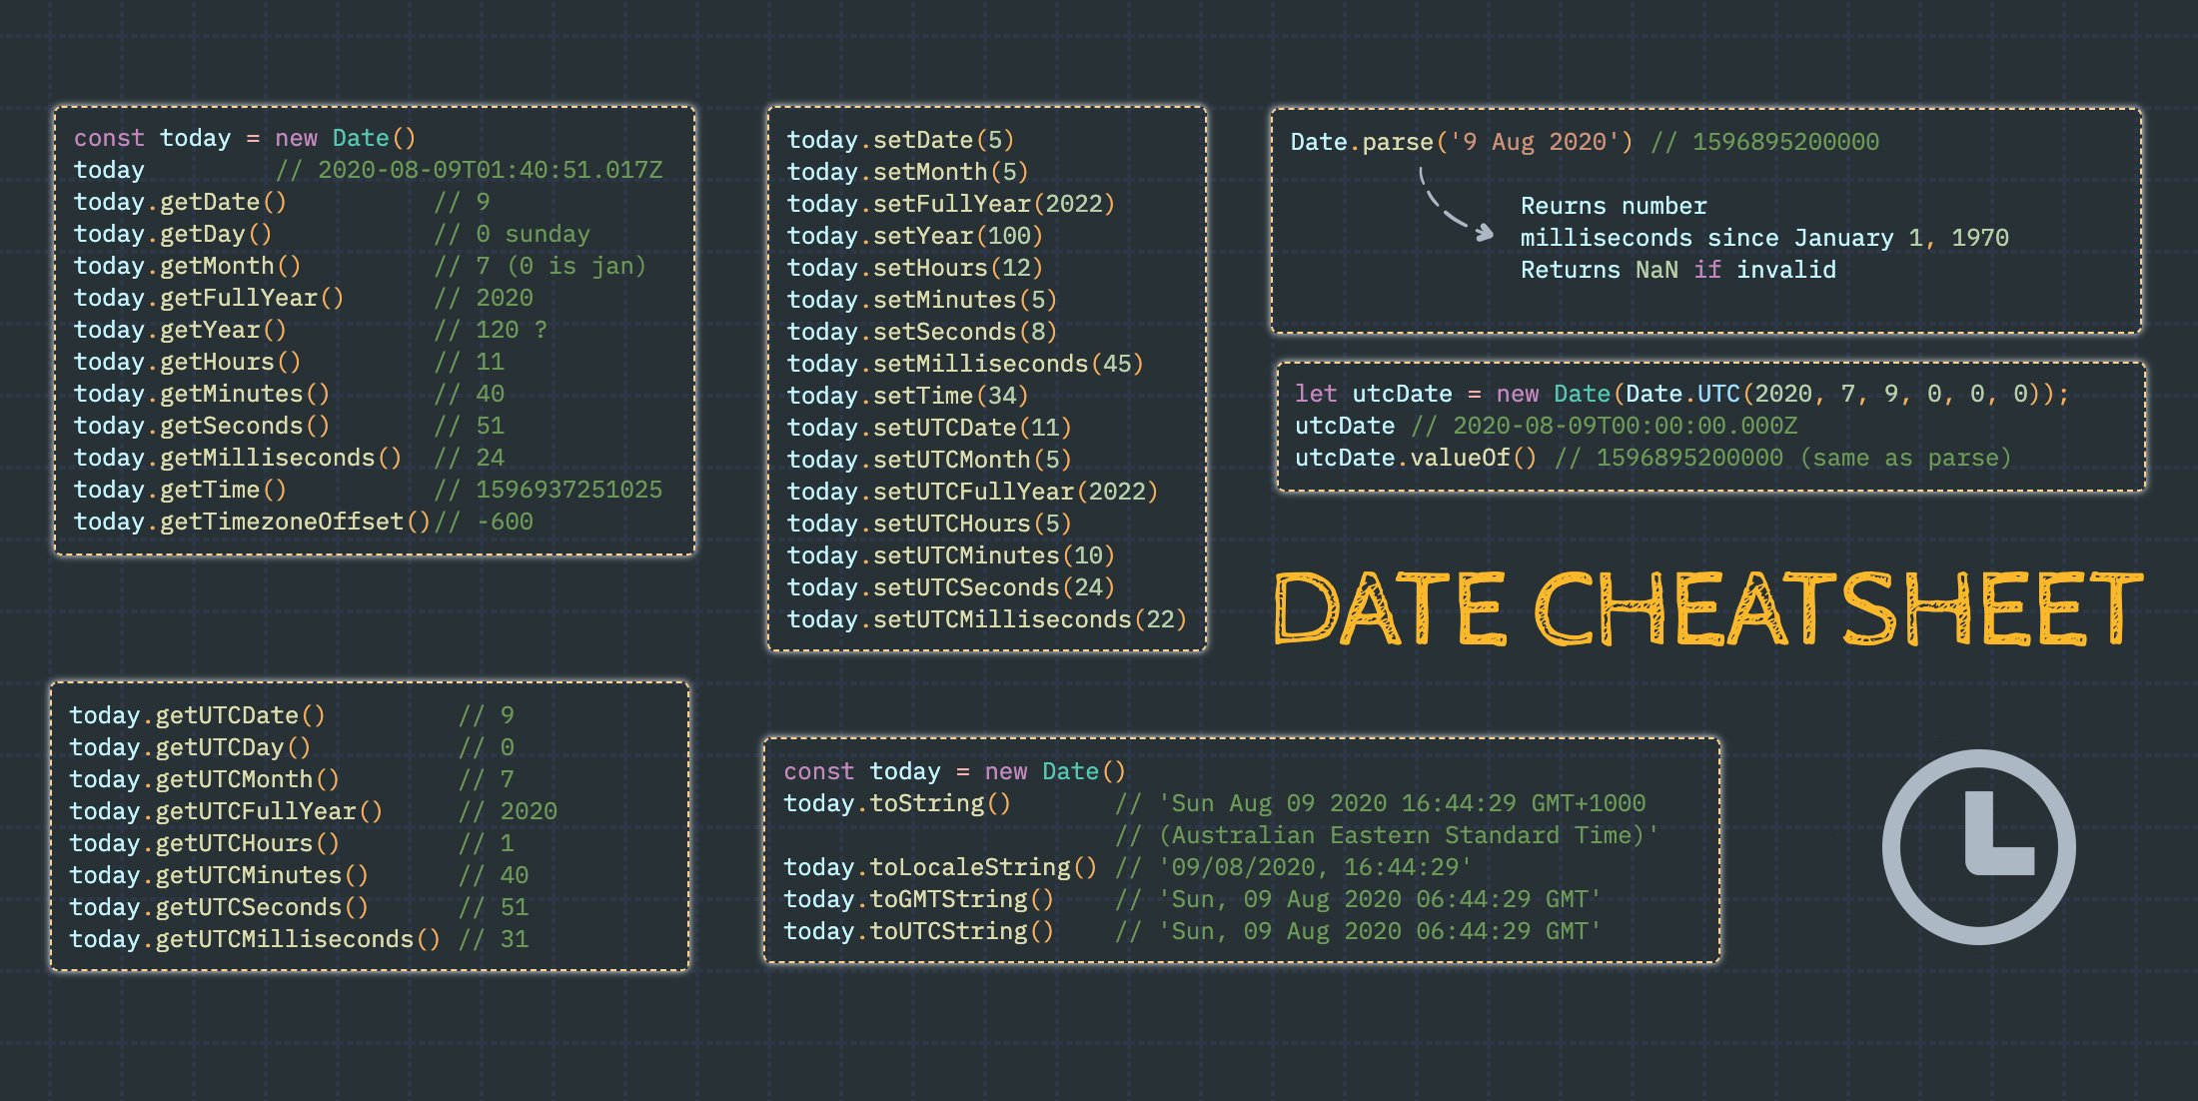
Date object
1- get methods

Slide 22
Date object
1- set methods

Slide 23
Date object
1- to methods

Slide 24
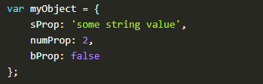
Literal object
JavaScript Object Literal is a data type used to define objects in JavaScript. It is a syntax for creating an object in JavaScript that is composed of key-value pairs. It is a lightweight and efficient way to create and store data. It is a great way to store related data in an organized manner.

Slide 25
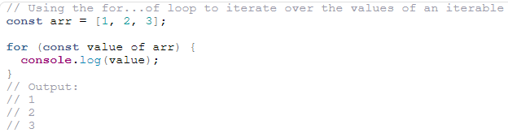
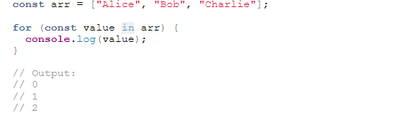
For of & For in
For - of
For - in

Slide 26
Thanks!
Do you have any questions?
asmaaahmed23762@gmail.com

